Slide 1

Concept

Slide 2
CUSTOMER NAME
Devu Tools
PROJECT
YXA
PART NAME
Guard_Assy.Side Sill_Splas
PART NO.
77230-58000
TYPE
Checking Fixture
DATE
22-12-2024

Slide 3
Part Images
A Surface
B Surface

Slide 4
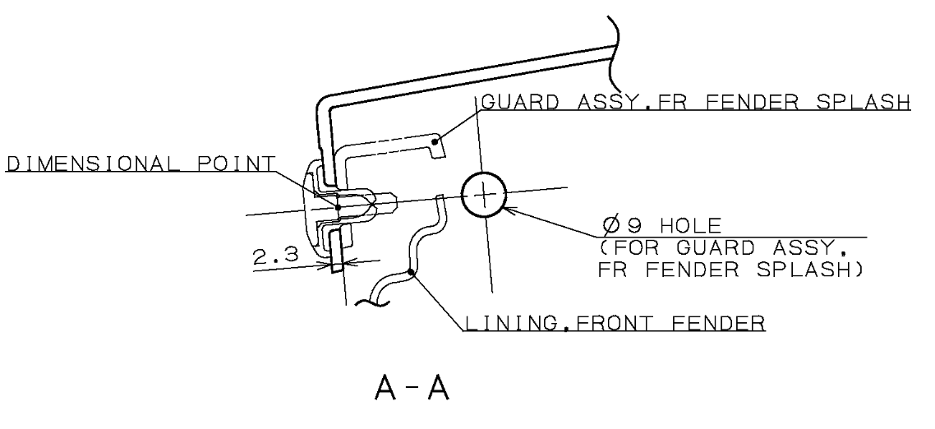
Resting & Locking
A
A
A-A
Part Hole Size:-Ø9mm
Pin Size:- Ø8.9mm
Part
Thread Pin
Stand
Bush(Resting)
Base Plate
Thread pin will be provided to rest and lock the part at 1 place as per drawing tolerance as shown above.

Slide 5
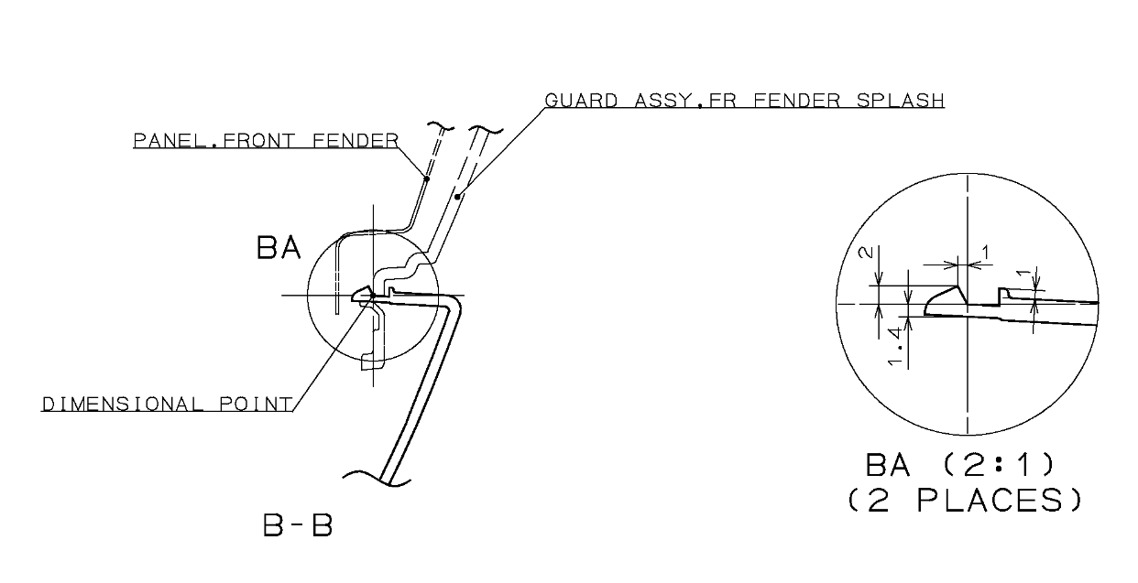
Locking
B
B-B
B
Stand
Mechanism
Base Plate
Part
One side locking mechanism will be provided as per surround to lock the part at 2 places as shown above.

Slide 6
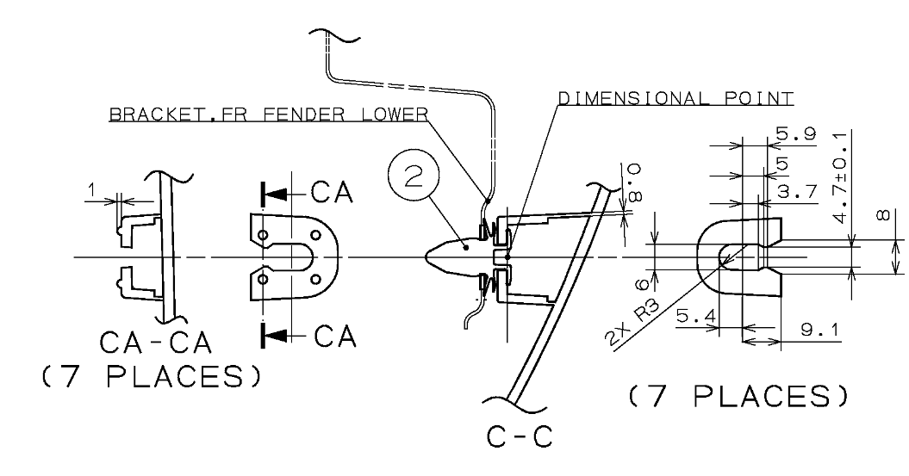
Resting & Locking
C
C-C
C
Mechanism
Surrounding missing for marked area and in another 6 places we received only surface thickness is required
Part
Base Plate
Clutch operated mechanism will be provided as per surrounding to lock and rest the part at 07 places as shown above.

Slide 7
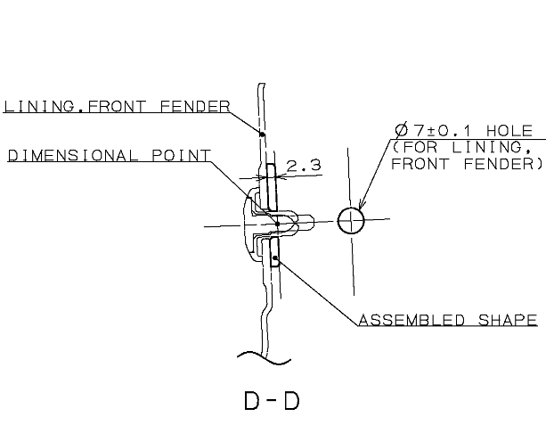
Resting & Locking
D-D
D
D
Part Hole Size:-Ø7mm
Pin Size:- Ø6.9mm
Part
Thread Pin
Stand
Bush(Resting)
Base Plate
The drawing and CAD model do not match; a hole shown in the drawing is missing in the CAD model
Thread pin will be provided to rest and lock the part at 1 place as per drawing tolerance as shown above.

Slide 8
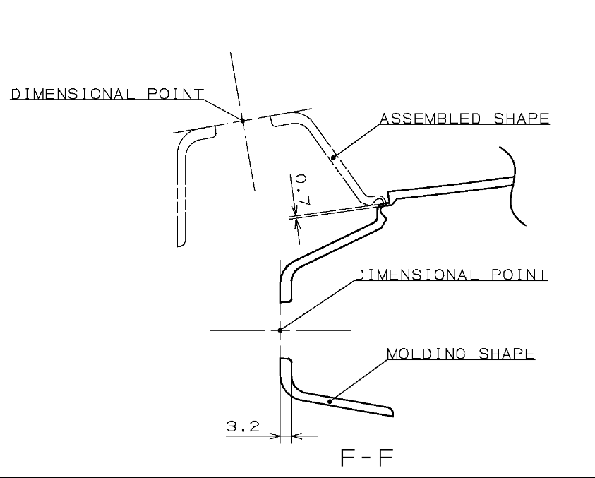
Resting & Locking
F-F
F
F
Part Hole Size:-Ø16mm
Pin Size:- Ø15.8mm
Part
Thread Pin
Stand
Bush(Resting)
Base Plate
Thread pin will be provided to rest and lock the part as per drawing tolerance as shown above.

Slide 9
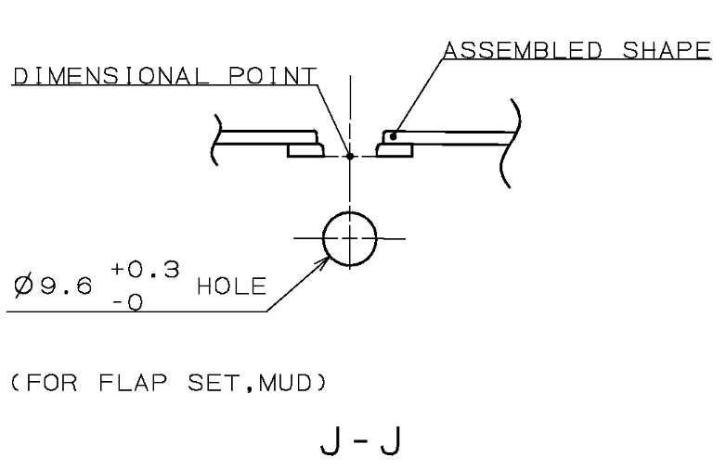
Resting & Locking
J-J
J
J
Part Hole Size:-Ø9.6mm
Pin Size:- Ø9.6mm
Stand
Part
Thread Pin
Base Plate
Thread pin will be provided to rest and lock the part as per drawing tolerance as shown above.

Slide 10
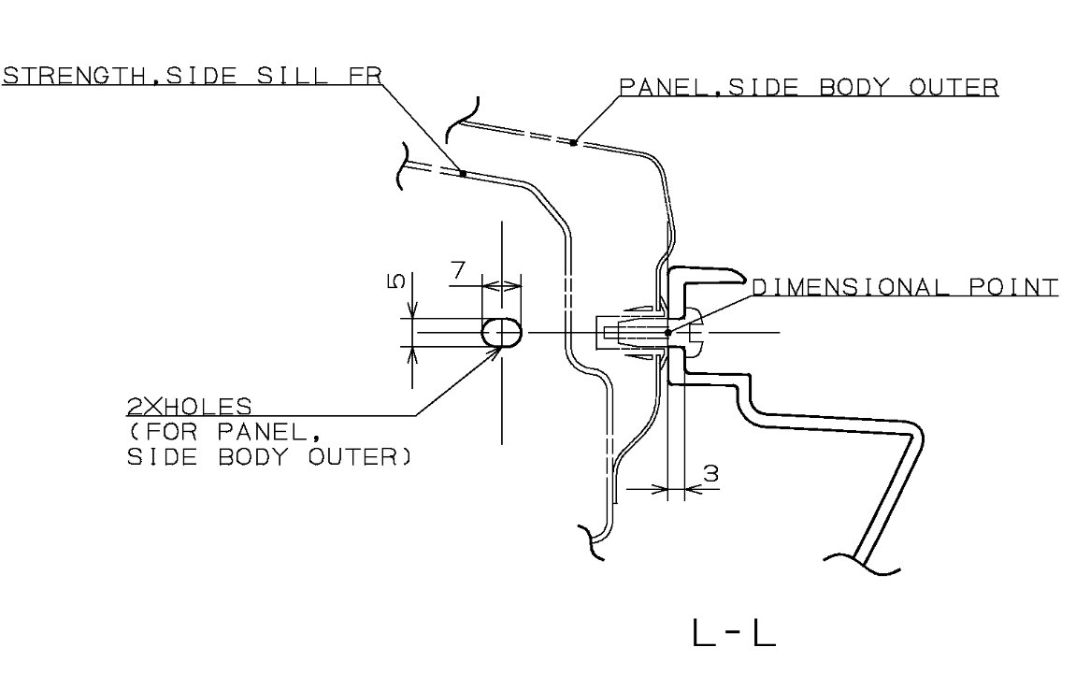
Resting & Locking
L
L-L
L
Part Hole Size:-5x7
Pin Size:- Ø4.9mm
Stand
Thread Pin
Part
Base Plate
Thread pin will be provided to rest and lock the part as per drawing tolerance as shown above.

Slide 11
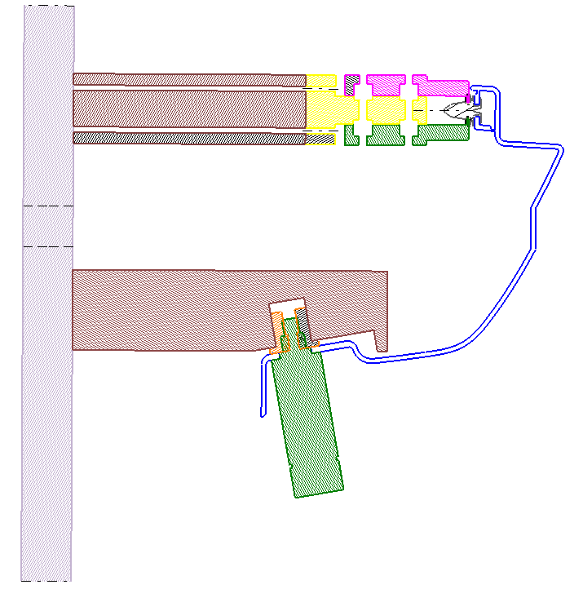
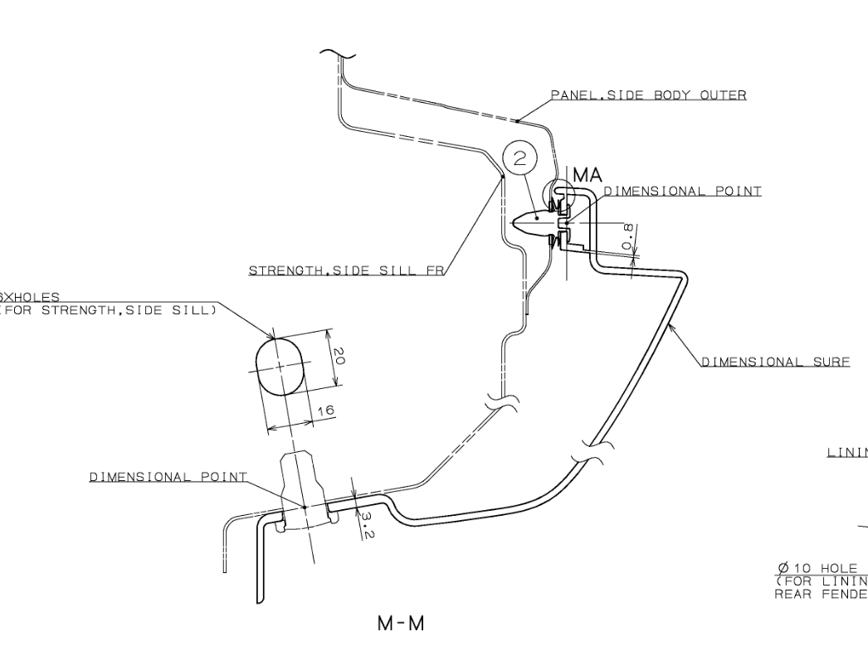
Resting & Locking
M
M-M
M
Mechanism
The required panel thickness has not been provided; only the surface were received
Stand
Part
Thread Pin
Base Plate
Mechanism and thread pin will be provided as shown above

Slide 12
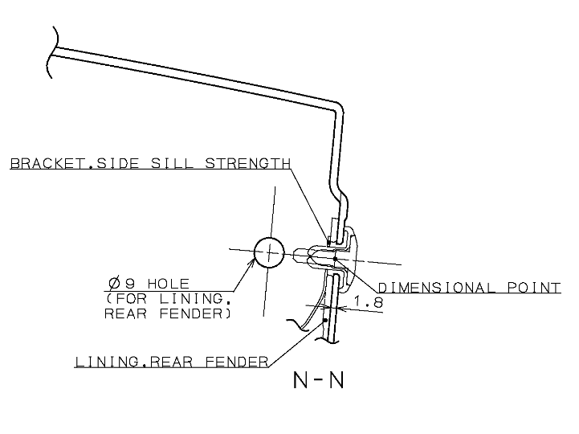
Resting & Locking
N
N
N-N
Part Hole Size:-Ø8mm
Pin Size:- Ø7.9mm
Part
Thread Pin
Stand
Base Plate
Thread pin will be provided to rest and lock the part at 1 place as per drawing tolerance as shown above.

Slide 13
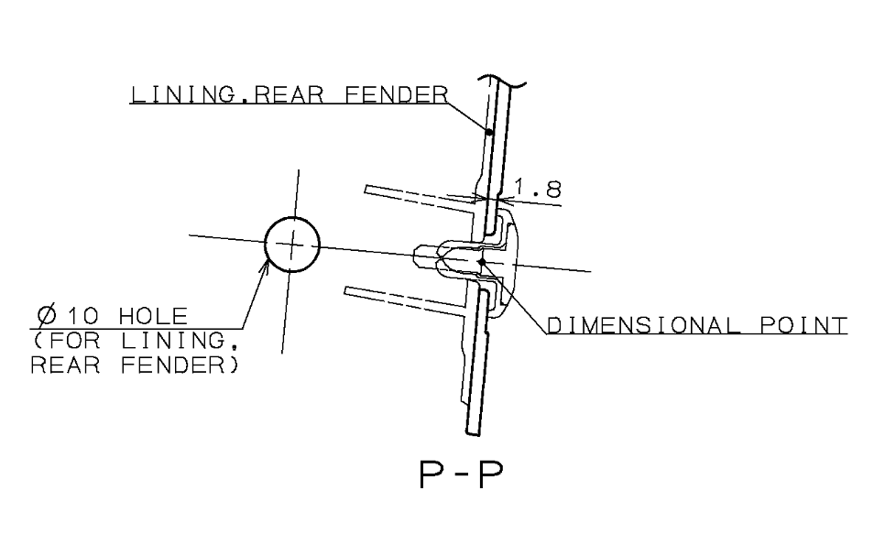
Resting & Locking
P-P
P
P
Part Hole Size:-Ø10mm
Pin Size:- Ø9.9mm
Part
Thread Pin
Stand
Base Plate
Thread pin will be provided to rest and lock the part at 1 place as per drawing tolerance as shown above.

Slide 14
Gap Flush
Q
Q-Q
Swing Template
Stand
Q
Surrounding required at highlighted area
0
Base Plate
3
Body
Part
3
Swing template will be provided with 3mm gap and 0 mm flush and Body will be provided with 3mm gap and 0,3 mm trimline as shown above.

Slide 15
Gap Flush
S
S-S
R
R
S
Part
Surrounding required at highlighted area
3
Part
3
Body
Body
Base Plate
Gap and Flush body will be provided all around the part with 3mm gap and 0 mm flush as shown in above image.
Base Plate
R-R

Slide 16
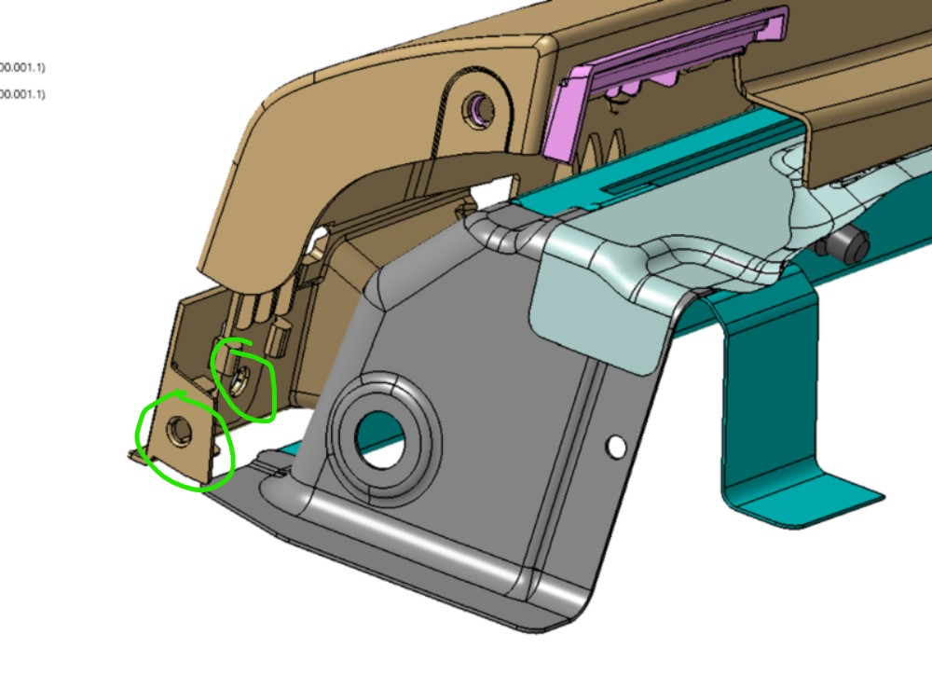
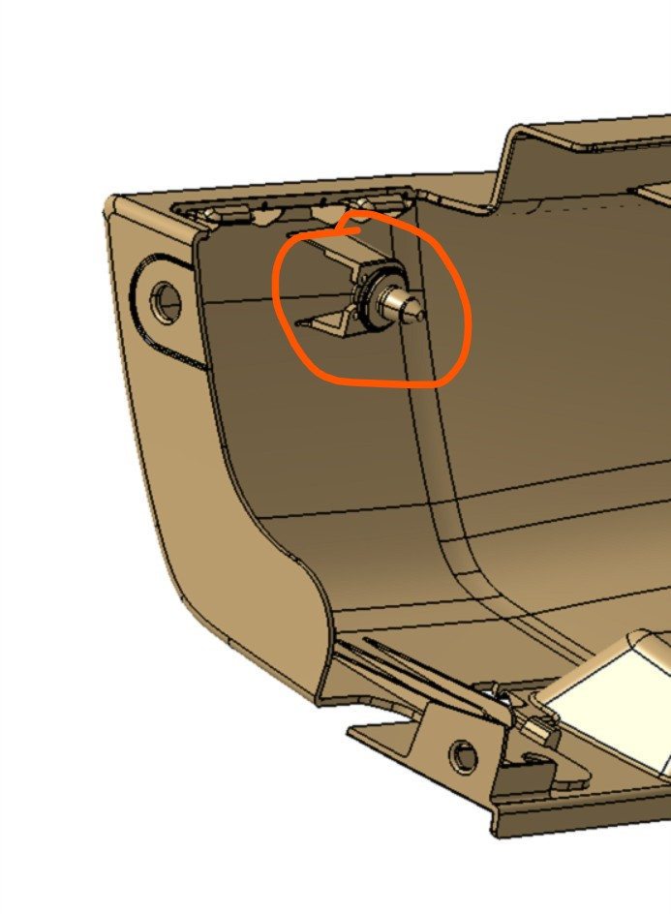
Surrounding
Surrounding not received
Only surface received

Slide 17
Fixture Orientation
Isometric
Top
Front
Side

Slide 18
Thank You

